Slide 1
Embargoed Until 10:45 a.m. ET, Tuesday, Nov. 10, 2015
Individualizing Treatment Duration of Dual Antiplatelet Therapy after Percutaneous Coronary Intervention: An Analysis from the DAPT Study
Robert W. Yeh, Eric A. Secemsky, Dean J. Kereiakes, Sharon-Lise T. Normand, Anthony H. Gershlick, David J. Cohen, John A. Spertus, P. Gabriel Steg, Donald E. Cutlip, Michael J. Rinaldi, Edoardo Camenzind, William Wijns, Patricia K. Apruzzese, Yang Song, Joseph M. Massaro, and Laura Mauri, for the Dual Antiplatelet Therapy (DAPT) Study Investigators

Slide 2
Disclosures
Funding
The DAPT Study was sponsored by Harvard Clinical Research Institute, and funded by Abbott, Boston Scientific Corporation, Cordis Corporation, Medtronic, Inc., Bristol-Myers Squibb Company/Sanofi Pharmaceuticals Partnership, Eli Lilly and Company, and Daiichi Sankyo Company Limited and the US Department of Health and Human Services (1RO1FD003870-01).
This analysis was supported by the National Heart, Lung and Blood Institute (K23HL118138) and Harvard Clinical Research Institute.
Disclosures
Personal fees from Abbott Vascular, Boston Scientific, and Merck.

Slide 3
Background
In the DAPT Study, continuation of dual antiplatelet therapy beyond 12 months reduced ischemic complications after coronary stenting compared with aspirin alone, yet increased moderate or severe bleeding.
Risk Difference (Continued Thienopyridine – Placebo), 12-30M
Stent
Thrombosis
Death, MI,
Or Stroke
(MACCE)
Myocardial
Infarction
GUSTO
Mod/Severe
Bleed
Death
HR 0.47 (0.37–0.61)
P<0.001
HR 0.71 (0.59–0.85)
P<0.001
Mauri, Kereiakes, Yeh et al. NEJM. 2014 Dec 4:371:2155-66.

Slide 4
Objective
  To develop a decision tool to identify whether an individual patient is more likely to derive benefit or harm from continuation of dual antiplatelet therapy beyond 1 year.
    Simultaneously accounting for risks of ischemia AND bleeding with continued therapy.

Slide 5
Design
Inclusion: FDA-approved DES or BMS, candidates for thienopyridine
Excluded: Oral anticoagulant therapy; life expectancy < 3y
Randomized: Free from MI, stroke, repeat revascularization, moderate/severe bleeding, and adherent with therapy at 12 months
Mauri, Kereiakes et al. AHJ. 2010;160(6): 1035-41. ClinicalTrials.gov number NCT00977938
5
5
Notes:
5

Slide 6
Methods – Models to Predict
Ischemic and Bleeding Events
Development of 2 Prediction Models within the randomized DAPT Study population (N=11648).
Ischemic Model: Myocardial infarction or stent thrombosis between 12-30 months after index PCI. Includes fatal events.
Bleeding Model: GUSTO moderate or severe bleeding between 12-30 months after index PCI. Includes fatal events.
Cox regression, stepwise selection among 37 candidate variables, including randomized treatment arm. In addition, several interaction terms with treatment arm evaluated. P value of 0.05 for retention.
Validated externally within the PROTECT trial population*
*Camenzind, Wijns, Mauri et al. Lancet. 380;9851:1396-1405.

Slide 7
Methods – Predicting Net
Treatment Effect
Predicted Ischemic Event Rate with Placebo
Predicted Ischemic Event Rate with Rx
Predicted Bleeding Event Rate with Rx
Predicted Bleeding Event Rate with Placebo
Predicted Risk Reduction in Ischemic Events
(Beneficial Effect)
Predicted Risk Increase in Bleeding Events
(Harmful Effect)
Predicted Net Treatment Effect
(Range from Negative to Positive)
Predictors of net treatment effect with continued thienopyridine determined from linear regression and simplified to an integer point score (DAPT Score)
Actual outcomes presented by randomized treatment arm stratified by DAPT Score. Sensitivity analysis without paclitaxel-eluting stent-treated subjects.

Slide 8
Baseline Characteristics; All Randomized Patients With vs. Without Ischemic or Bleeding Events
 | Myocardial Infarction or Stent Thrombosis Events |  |  | GUSTO Severe/Moderate Events
Measure* | MI or Stent Thrombosis N=348 | No MI or Stent Thrombosis N=11300 | P | Bleeding N=215 | No Bleeding N=11433 | P
Age (years) | 61.7 | 61.3 | 0.47 | 66.4 | 61.2 | <.001
Female | 26.4% | 25.1% | 0.57 | 29.3% | 25.0% | 0.15
BMI (Kg/m²) | 30.1 | 30.4 | 0.28 | 29.5 | 30.4 | 0.01
Diabetes mellitus | 39.9% | 28.9% | <.001 | 31.3% | 29.2% | 0.50
Hypertension | 81.0% | 73.1% | <.001 | 84.2% | 73.2% | <.001
Cigarette smoker | 33.0% | 27.2% | 0.02 | 18.2% | 27.6% | 0.002
Congestive heart failure | 10.4% | 4.3% | <.001 | 8.0% | 4.5% | 0.02
LVEF < 30% | 4.6% | 1.9% | 0.002 | 3.1% | 1.9% | 0.28
Prior PCI | 42.4% | 28.6% | <.001 | 37.7% | 28.9% | 0.01
Prior CABG | 17.5% | 10.5% | <.001 | 14.4% | 10.7% | 0.09
Prior myocardial infarction | 32.7% | 21.1% | <.001 | 22.2% | 21.4% | 0.80
Indication for index procedure
STEMI | 14.4% | 14.4% | 1.00 | 10.2% | 14.5% | 0.08
NSTEMI | 22.1% | 16.1% | 0.004 | 12.1% | 16.4% | 0.11
Renal insufficiency/failure | 7.9% | 3.9% | 0.001 | 9.4% | 3.9% | <.001
Peripheral arterial disease | 10.9% | 5.5% | <.001 | 14.3% | 5.5% | <.001
Continued thienopyridine | 35.3% | 50.8% | < 0.001 | 62.8% | 50.1% | < 0.001

Slide 9
Multivariable Prediction Models
 | Predictors of Myocardial Infarction or Stent Thrombosis |  | Predictors of Moderate/Severe Bleeding
Predictors of Events | HR (95% CI) | P | HR (95% CI) | P
Continued Thienopyridine vs. Placebo | 0.52 (0.42 – 0.65) | <0.001 | 1.66 (1.26 - 2.19) | <0.001
MI at Presentation | 1.65 (1.31 – 2.07) | <0.001 | - | -
Prior PCI or Prior MI | 1.79 (1.43 – 2.23) | <0.001 | - | -
CHF or LVEF < 30% | 1.88 (1.35 – 2.62) | <0.001 | - | -
Vein Graft PCI | 1.75 (1.13 – 2.73) | 0.01 | - | -
Stent Diameter < 3 mm | 1.61 (1.30 – 1.99) | <0.001 | - | -
Paclitaxel-Eluting Stent | 1.57 (1.26 – 1.97) | <0.001 | - | -
Cigarette Smoker | 1.40 (1.11 – 1.76) | 0.01 | - | -
Diabetes | 1.38 (1.10 – 1.72) | 0.01 | - | -
Peripheral Arterial Disease | 1.49 (1.05 – 2.13) | 0.03 | 2.16 (1.46, 3.20) | <0.001
Hypertension | 1.37 (1.03 – 1.82) | 0.03 | 1.45 (1.00, 2.11) | 0.05
Renal Insufficiency | 1.55 (1.03 – 2.32) | 0.04 | 1.66 (1.04, 2.66) | 0.03
Age (per 10 years) | - | - | 1.54 (1.34, 1.78) | <0.001

Slide 10
Predictors of Net Treatment Effect
Characteristics | Impact on Net Treatment Effect | % of Variation Explained
Age ≥ 75 Age 65 - < 75 Age < 65 (reference) | -1.2% -0.5% - | 6.0% 2.1% -
Prior PCI or MI | 1.1% | 14.6%
Stent Diameter < 3 mm | 0.9% | 10.1%
CHF or LVEF < 30% | 1.9% | 9.9%
MI at Presentation | 1.0% | 9.6%
Paclitaxel-Eluting Stent | 1.0% | 8.8%
Cigarette Smoker | 0.7% | 4.3%
Diabetes | 0.6% | 4.3%
Vein Graft PCI | 1.6% | 3.7%
Hypertension | 0.2% | 0.4%
Renal Insufficiency | 0.4% | 0.3%
PAD | -0.1% | 0.04%
Bleeding
Predictors
Ischemia
Predictors
Bleeding
and
Ischemia
Predictors

Slide 11
The DAPT Score
Variable | Points
Patient Characteristic
Age
≥ 75 | -2
65 - <75 | -1
< 65 | 0
Diabetes Mellitus | 1
Current Cigarette Smoker | 1
Prior PCI or Prior MI | 1
CHF or LVEF < 30% | 2
Index Procedure Characteristic
MI at Presentation | 1
Vein Graft PCI | 2
Stent Diameter < 3mm | 1
Distribution of DAPT Scores among all
randomized subjects in the DAPT Study

Slide 12
Continued Thienopyridine vs. Placebo
Treatment Effect by DAPT Score Quartile
(N = 11,648)
Q1 = DAPT Score -2 to 0
Q3 = DAPT Score 2
Q2 = DAPT Score 1
Q4 = DAPT Score > 2
Risk Difference (Continued Thienopyridine – Placebo), 12-30M
Q1 Q2 Q3 Q4
Q1 Q2 Q3 Q4
Q1 Q2 Q3 Q4

Slide 13
Continued Thienopyridine vs. Placebo
Treatment Effect by DAPT Score Quartile
(N = 11,648)
Risk Difference (Continued Thienopyridine – Placebo), 12-30M
Mortality
Net Adverse
Events
Q1 Q2 Q3 Q4
Q1 Q2 Q3 Q4
DAPT Score
< 2
DAPT Score
≥ 2
DAPT Score
< 2
DAPT Score
≥ 2
13
13

Slide 14
Continued Thienopyridine vs. Placebo DAPT Score <2 (Low); N=5731
Myocardial Infarction or Stent Thrombosis
Death, MI, or Stroke (MACCE)
10%
Continued Thienopyridine
Placebo
10%
Continued Thienopyridine
Placebo
8%
8%
6%
6%
Cumulative Incidence of ST/MI
Cumulative Incidence of MACCE
4%
1.7% vs. 2.3%
P=0.07
4%
3.7% vs. 3.8%
P=0.73
2%
2%
0%
0%
12
15
18
21
24
27
30
12
15
18
21
24
27
30
Months After Enrollment
Months After Enrollment
10%
Continued Thienopyridine
Placebo
8%
GUSTO
Moderate/
Severe
Bleeding
6%
Cumulative Incidence of GUSTO Moderate/
Severe Bleed
4%
3.0% vs. 1.4%
P<0.001
2%
0%
12
15
18
21
24
27
30
Months After Enrollment

Slide 15
Continued Thienopyridine vs. Placebo DAPT Score ≥ 2 (High); N=5917
Myocardial Infarction or Stent Thrombosis
Death, MI or Stroke (MACCE)
10%
Continued Thienopyridine
Placebo
10%
Continued Thienopyridine
Placebo
8%
8%
6%
6%
4.9% vs. 7.6%
P<0.001
Cumulative Incidence of ST/MI
2.7% vs. 5.7%
P<0.001
Cumulative Incidence of MACCE
4%
4%
2%
2%
0%
0%
12
15
18
21
24
27
30
12
15
18
21
24
27
30
Months After Enrollment
Months After Enrollment
10%
Continued Thienopyridine
Placebo
8%
GUSTO
Moderate/
Severe
Bleeding
6%
1.8% vs. 1.4%
P=0.26
Cumulative Incidence of GUSTO Moderate/
Severe Bleed
4%
2%
0%
12
15
18
21
24
27
30
Months After Enrollment

Slide 16
Continued Thienopyridine vs. Placebo High vs. Low DAPT Score
Myocardial Infarction
or Stent Thrombosis
GUSTO Moderate
or Severe Bleed
Net Adverse
Events
Mortality
Risk Difference
(Continued Thienopyridine – Placebo), 12-30M
P<0.001
P=0.02
P<0.001
P=0.14
P values are for comparison of risk differences across DAPT Score category (interaction).

Slide 17
Continued Thienopyridine vs. Placebo, by DAPT Score, Excluding PES
Myocardial Infarction
or Stent Thrombosis
GUSTO Moderate
or Severe Bleed
Net Adverse
Events
Mortality
Risk Difference
(Continued Thienopyridine – Placebo), 12-30M
P=0.06
P=0.07
P=0.003
P=0.17
P values are for comparison of risk differences across DAPT Score category (interaction).

Slide 18
Limitations
  Modest discrimination of ischemic and bleeding models
    Greater than values observed in many validation cohorts for the CH₂AD₂-VASC or HAS-BLED Scores*
    In PROTECT, high DAPT score patients had higher ischemic risk (HR 2.01, p = 0.002) AND trend toward lower bleeding risk (HR 0.69, p = 0.31), compared with low DAPT score patients
Post hoc analysis, not powered to examine differences in individual outcomes between subgroups
  Limited ability to identify rare or unmeasured predictors of events
  Models not evaluated in patients receiving ticagrelor or other antiplatelet combinations
*Lip et al. Chest. 2010;137(2):263-272.
Lip et al. JACC 2011:57(2):173-180.

Slide 19
Conclusions
  Among patients who have not had a major ischemic or bleeding event within the first year after PCI:
  The DAPT Score identified patients for whom ischemic benefits outweighed bleeding risks, and patients for whom bleeding risks outweighed ischemic benefits.
Low DAPT Score (< 2)
NNT to prevent ischemia = 153
NNH to cause bleeding = 64
High DAPT Score ≥ 2
NNT to prevent ischemia = 34
NNH to cause bleeding = 272
-2
10
DAPT Score may help clinicians decide who should,
and who should not be treated with extended DAPT

Slide 20
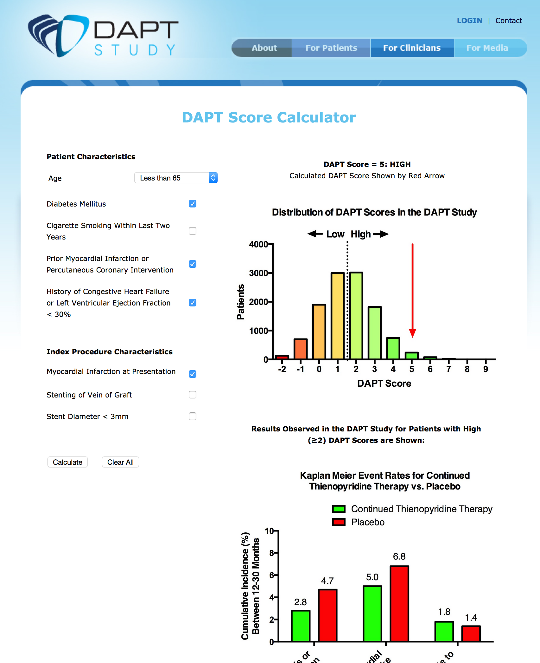
DAPT Score Calculator
DAPT Score calculator
www.daptstudy.org
Thank you!

Slide 21
Outcomes by DAPT Score Group – All Randomized Patients
Event | N | Continued Thienopyridine N = 5862 | Placebo N = 5786 | RD [95% CI] Continued Thienopyridine - Placebo | Log Rank P Value
GUSTO Moderate Bleeding
DAPT Score < 2 | 5731 | 54 (1.9%) | 28 (1.0%) | 0.94% [0.29%, 1.58%] | 0.004
DAPT Score ≥ 2 | 5917 | 37 (1.3%) | 24 (0.9%) | 0.42% [-0.12%, 0.97%] | 0.12
GUSTO Severe Bleeding
DAPT Score < 2 | 5731 | 29 (1.0%) | 13 (0.5%) | 0.58% [0.12%, 1.04%] | 0.01
DAPT Score ≥ 2 | 5917 | 15 (0.5%) | 16 (0.6%) | -0.057% [-0.45%, 0.34%] | 0.79
BARC 3, 5 Bleeding
DAPT Score < 2 | 5731 | 89 (3.2%) | 40 (1.4%) | 1.76% [0.96%, 2.57%] | <.001
DAPT Score ≥ 2 | 5917 | 56 (1.9%) | 39 (1.4%) | 0.54% [-0.13%, 1.22%] | 0.11
Cardiovascular Death
DAPT Score < 2 | 5731 | 20 (0.7%) | 16 (0.6%) | 0.15% [-0.28%, 0.58%] | 0.49
DAPT Score ≥ 2 | 5917 | 34 (1.2%) | 41 (1.5%) | -0.28% [-0.88%, 0.33%] | 0.35
Non-Cardiovascular Death
DAPT Score < 2 | 5731 | 26 (0.9%) | 10 (0.4%) | 0.58% [0.15%, 1.01%] | 0.01
DAPT Score ≥ 2 | 5917 | 26 (0.9%) | 17 (0.6%) | 0.29% [-0.17%, 0.75%] | 0.21

Slide 22
Baseline Characteristics; All Randomized Patients With vs. Without Ischemic or Bleeding Events
 | MI and/or Definite/Probable Stent Thrombosis Events |  |  | GUSTO Severe/Moderate Events
Measure* | Event N=348 Patients | No Event N=11300 Patients | P Value | Event N=215 Patients | No Event N=11433 Patients | P Value
Continued thienopyridine (Vs. Placebo) | 35.3% | 50.8% | < 0.001 | 62.8% | 50.1% | < 0.001
Stent Type |  |  | 0.64 |  |  | 0.12
Drug-Eluting | 86.5% | 85.5% |  | 89.3% | 85.4%
Bare Metal | 13.5% | 14.5% |  | 10.7% | 14.6%
No. treated vessels | 1.1±0.3 | 1.1±0.3 | 0.84 | 1.1±0.3 | 1.1±0.3 | 0.87
No. stents | 1.5±0.8 | 1.4±0.7 | 0.11 | 1.4±0.7 | 1.4±0.7 | 0.58
>2 vessels stented | 0.0% | 0.43% | 0.41 | 0.0% | 0.4% | 1.00
Total stent length (mm) | 28.1±16.8 | 27.0±16.43 | 0.21 | 26.1±15.0 | 27.1±16.5 | 0.39
Vein bypass graft stented | 6.3% | 2.7% | <.001 | 3.7% | 2.8% | 0.40
Thrombus-containing lesion | 15.3% | 14.2% | 0.57 | 9.6% | 14.3% | 0.06
Minimum stent diameter <3mm | 55.5% | 42.9% | <0.001 | 44.2% | 43.3% | 0.78

Slide 23
Conclusions
  The DAPT Score accurately identifies patients with the greatest anticipated benefit vs. harm from continuing dual antiplatelet therapy beyond 12 months among randomized patients in the DAPT Study
Low DAPT Score (< 2)
NNT to prevent ischemia = 153
NNH to cause bleeding 64
High DAPT Score ≥ 2
NNT to prevent ischemia = 34
NNH to cause bleeding = 272
Notes:
NNTB 235 for stent thrombosis; NNTB 98 for MI; NNTH 83 for bleeding.

Slide 24
Predicted Benefit vs. Harm with Continued Thienopyridine at 12-30M
Heterogeneity in
Predicted benefit
and risk
DAPT Study
2.0% reduction in MI
0.9% increase in bleeding
Notes:
Delete Slid

Slide 25
Observed Event Rates in High vs.
Low DAPT Score Groups in PROTECT
Notes:
Add details of population
Discuss C-statistics or add them here of the individual models.
?back up, or reference in a slide on valdation and sensitiviy analysis?
LM: back up, can put it as a line in the model limitations that it was good for predictive models, but did not have a large enough randomized duration dataset to validate DAPT score stratification.

Slide 26
The DAPT Score – All Randomized Patients
Variable | Points
Age
≥ 75 | -2
65 - <75 | -1
< 65 | 0
Current cigarette smoker | 1
Diabetes mellitus | 1
MI at presentation | 1
Prior PCI or prior MI | 1
Stent diameter < 3mm | 1
CHF or LVEF < 30% | 2
Vein graft PCI | 2
Notes:
Do I need a slide showing how we got these points?
LM: might show a slide transition from the prior making the common factors disappear – and leading to the left panel here. The histogram could be a separate slide, maybe even for later in the talk when you may want to show the proportion with high and low. Or maybe you can just put as back up since you can show n on top of other slides later.

Slide 27
Outcomes by DAPT Score Group – All Randomized Patients
Event | N | Continued Thienopyridine N = 5862 | Placebo N = 5786 |  | RD [95% CI] Continued Thienopyridine - Placebo | Log Rank P Value
Stent Thrombosis/MI
DAPT Score < 2 | 5731 | 46 (1.7%) | 65 (2.3%) |  | -0.66% [-1.40%, 0.09%] | 0.07
DAPT Score ≥ 2 | 5917 | 77 (2.7%) | 160 (5.7%) |  | -3.02% [-4.08%, -1.95%] | <0.001
MACCE
DAPT Score < 2 | 5731 | 102 (3.7%) | 107 (3.8%) |  | -0.15% [-1.16%, 0.86%] | 0.73
DAPT Score ≥ 2 | 5917 | 142 (4.9%) | 216 (7.6%) |  | -2.75% [-4.02%, -1.47%] | <0.001
Death
DAPT Score < 2 | 5731 | 46 (1.7%) | 26 (0.9%) |  | 0.73% [0.13%, 1.33%] | 0.02
DAPT Score ≥ 2 | 5917 | 60 (2.1%) | 58 (2.1%) |  | 0.01% [-0.73%, 0.76%] | 0.99
GUSTO Moderate/Severe Bleeding
DAPT Score < 2 | 5731 | 83 (3.0%) | 40 (1.4%) |  | 1.55% [0.76%, 2.33%] | <0.001
DAPT Score ≥ 2 | 5917 | 52 (1.8%) | 40 (1.4%) |  | 0.37% [-0.30%, 1.04%] | 0.26
Stent Thrombosis/MI or GUSTO Moderate/Severe Bleeding
DAPT Score < 2 | 5731 | 121 (4.4%) |  | 96 (3.4%) | 0.92% [-0.11%, 1.95%] | 0.08
DAPT Score ≥ 2 | 5917 | 120 (4.2%) |  | 193 (6.9%) | -2.70% [-3.91%, -1.49%] | <0.001

